Slide 1
Cybersecurity at WAJ
What is it?
Are we at risk?

Slide 2
Devices
111 Chromebooks
177 iPads
84 Surface Tablets
22 Galaxy Tablets
76 Laptops______
470 Mobile Devices
264 Desktops
734 Total Devices

Slide 3
Cybersecurity at WAJ
Are we at risk? Yes
What are we at risk of?

Slide 6
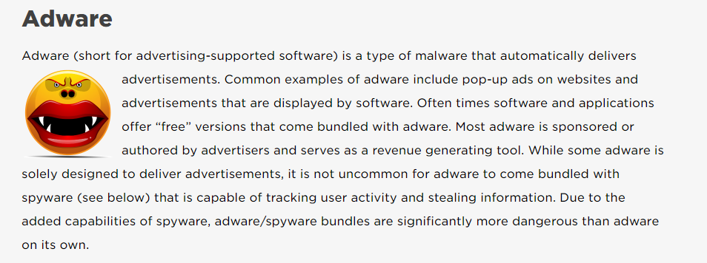

Slide 11
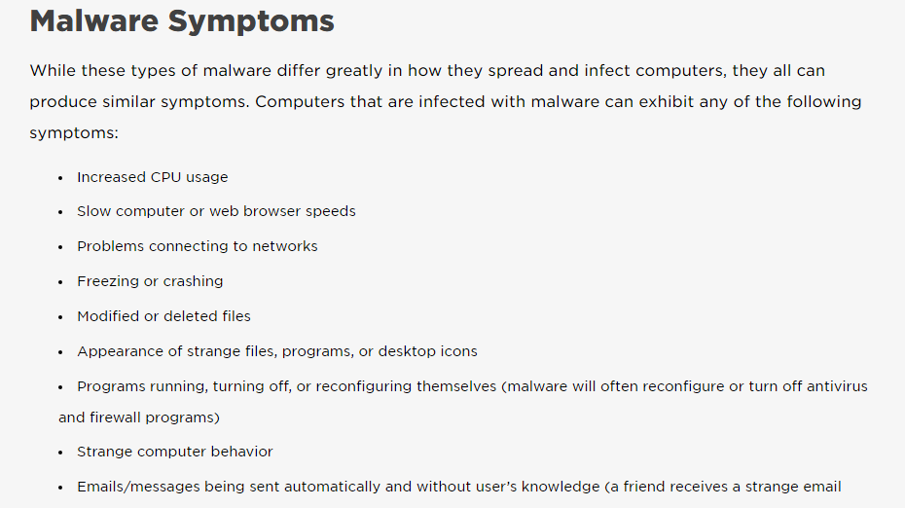

Slide 12
How are we protected at WAJ?
Firewall

Slide 13
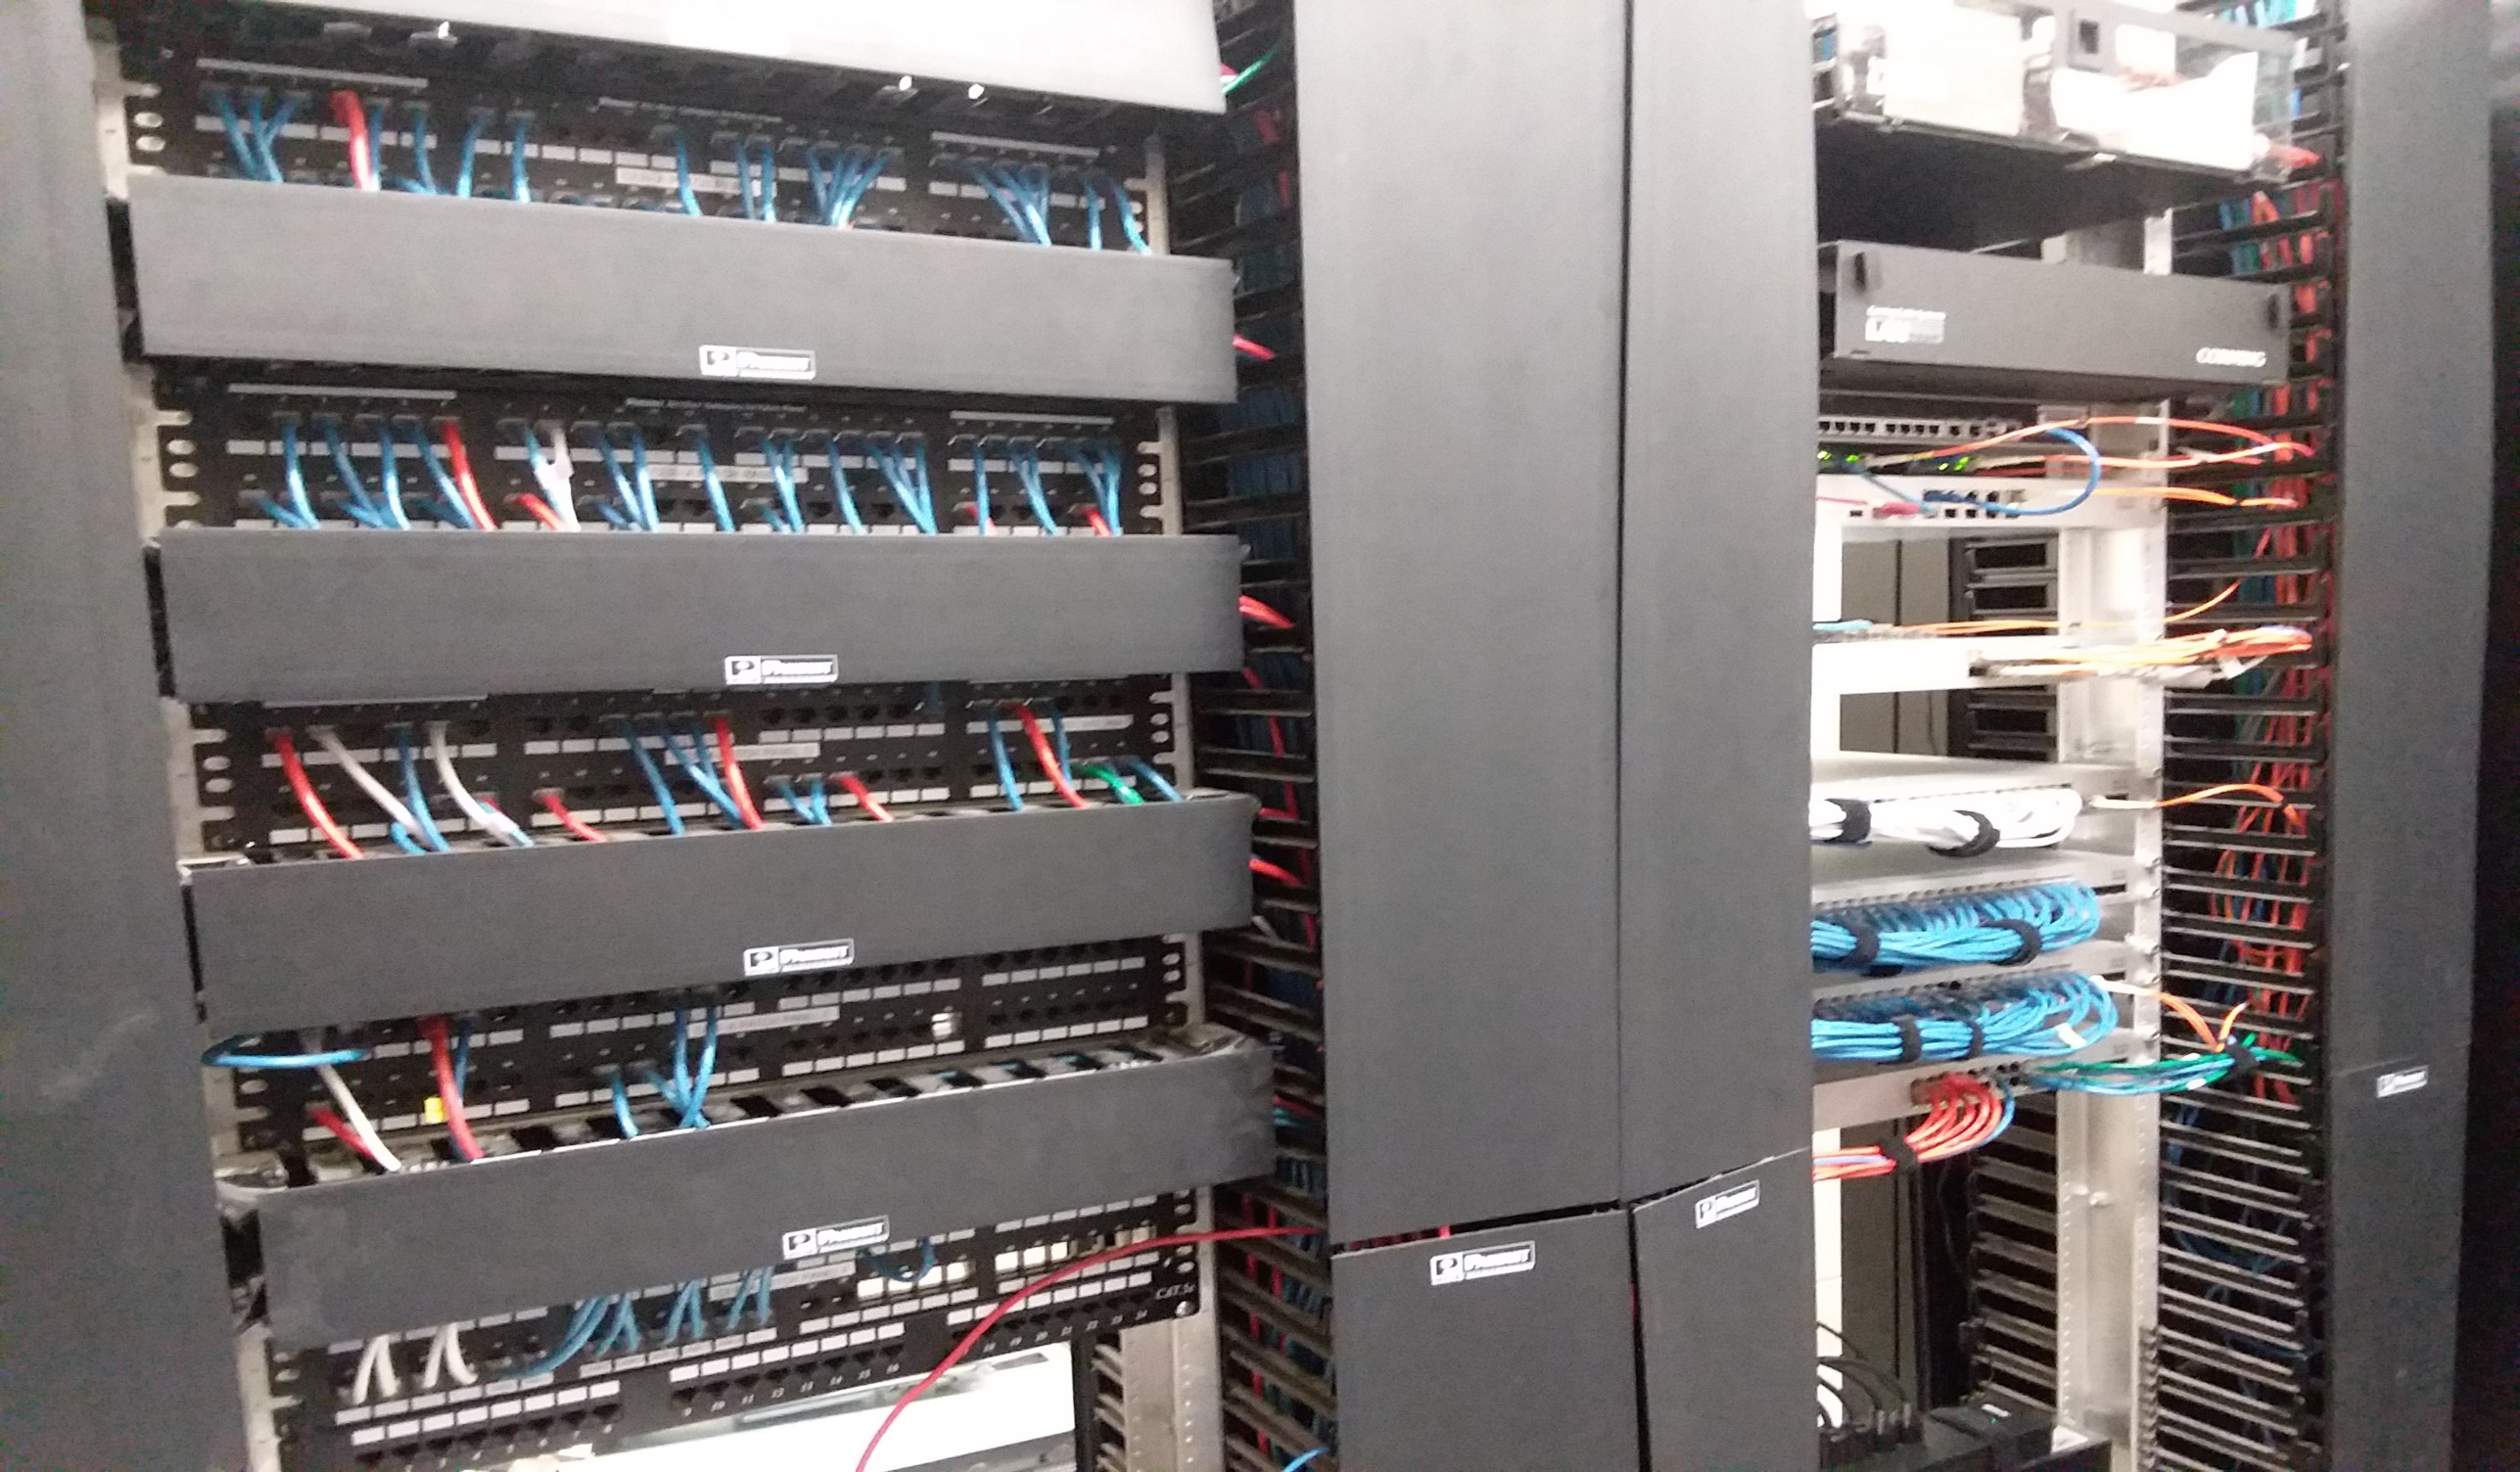

Slide 14
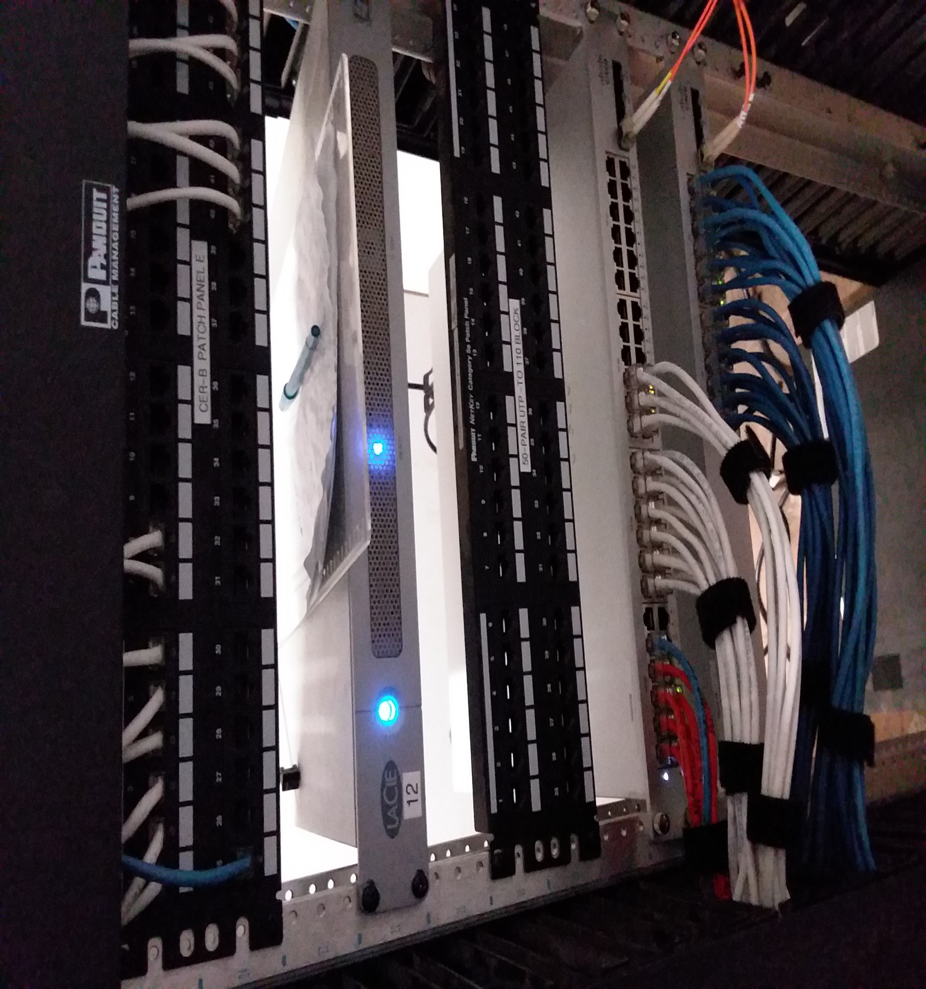

Slide 15
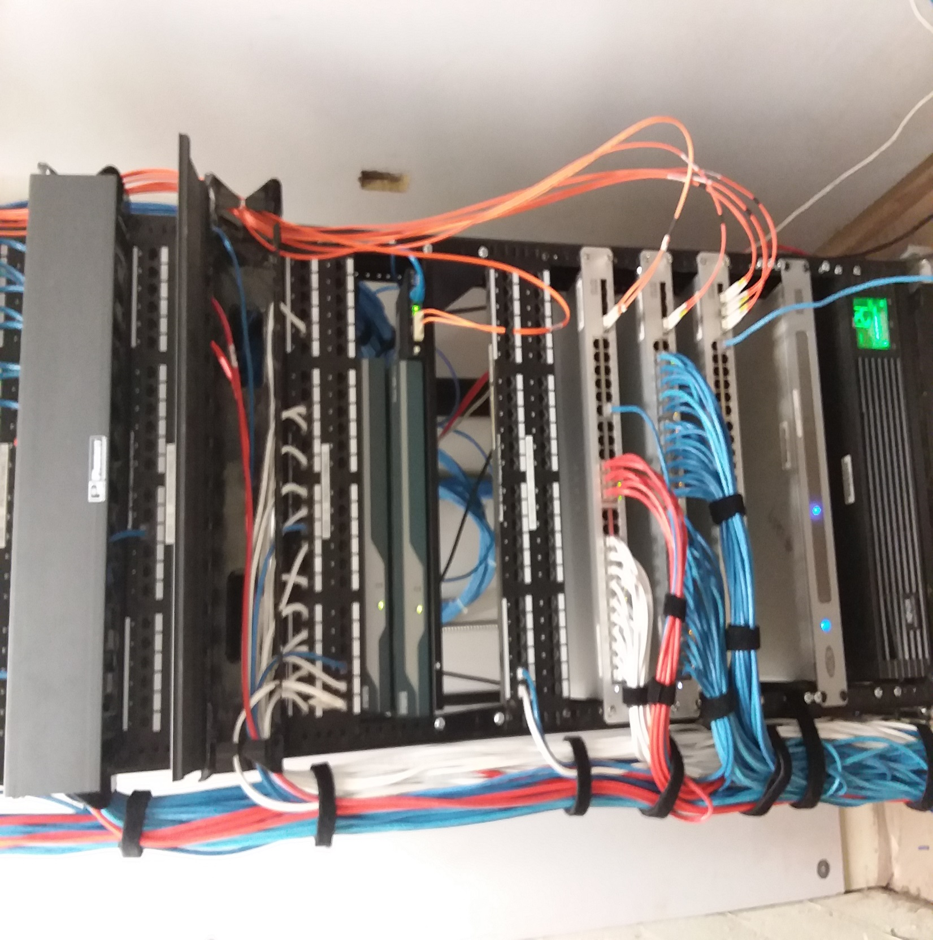

Slide 16
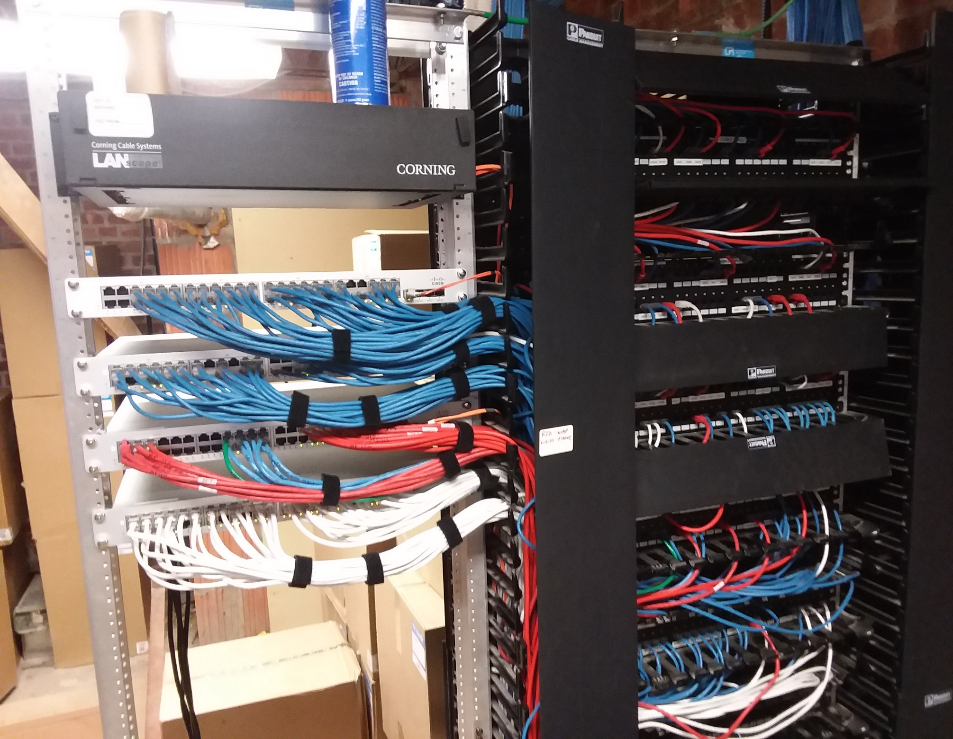

Slide 17
How are we protected at WAJ?
Firewall
Anti Virus software

Slide 18
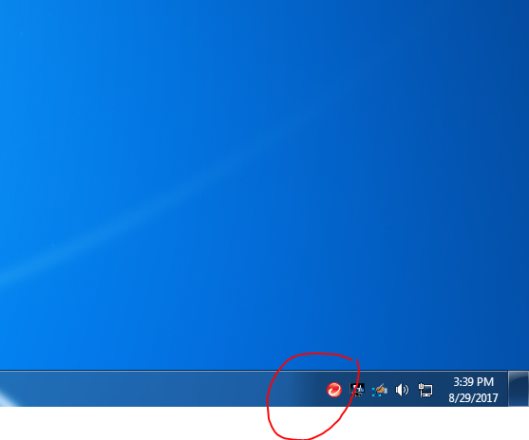

Slide 19
How are we protected at WAJ?
Firewall
Anti Virus software
Web Filter

Slide 20
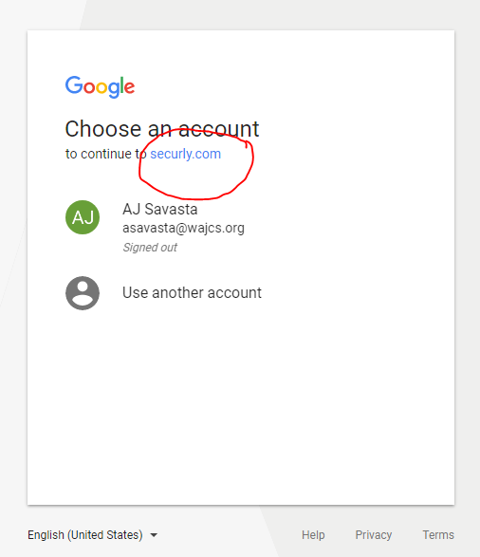

Slide 21
How are we protected at WAJ?
Firewall
Anti Virus software
Web Filter
Backups
Updates
Users

Slide 22
Myth or Fact
Open emails on your cell phone first since phones can’t get infected.
MAC Books don’t get infections.
A user must do something wrong for a computer to become infected.
All Devices can get infections.
Viruses won’t spread if the computer is turned off.

Slide 23
Tips for Safety
Updates
Use software to protect your device and data
Strong passwords
Don’t share passwords (especially email passwords)
Backup Data
Control Access to your device
Use email and internet wisely. If it looks suspicious….

